Slide 1
DEEP LEARNING

Slide 2
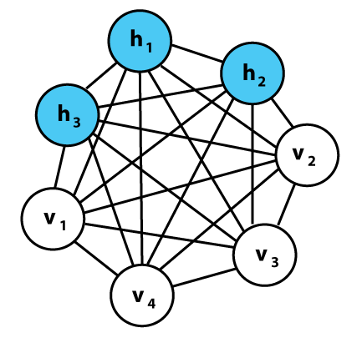
Boltzmann Machine
A Boltzmann machine is a network of symmetrically coupled stochastic binary units, can be seen as the stochastic, generative counterpart of Hopfield nets that make stochastic decisions about whether to be on or off.
It contains a set of visible units v ∈ {0, 1}^{D}, and a set of hidden units h ∈ {0, 1}^{P}

Slide 3
The stochastic dynamics of a Boltzmann machine
Unit i updating its binary state based on connections coming from other active units j: z_{i} = b_{i} + ∑_{j} s_{j} w_{ij}
w_{ij} is the weight between i and j, and s_{j} is 1 if unit j is on and 0 otherwise.
Unit i then turns on with a probability given by the logistic function:
p(s_{i} =1) = 1/ 1 + e^{-zi}
The network will eventually reach a Boltzmann distribution in which probability P⁻(V) at equilibrium is determined by relative energy function .
More specifically, the aim is to find weights and biases that define a Boltzmann distribution in which the training vectors have high probability.

Slide 4
Boltzman Machine
Boltzmann machines were introduced as a general “connectionist” approach to learning arbitrary probability distributions over binary input vectors.
The visible units are those that receive information from the training set V having distribution denoted by P⁺(V).
The distribution over the hidden units are attained at thermal equilibrium, denoted by P⁻(V).
Goal is to approximate the distribution P⁺(V) using P⁻(V).
To measure how similar the two distributions are, we use the Kullback–Leibler divergence G, a function of the weights.

Slide 5
Kullback–Leibler divergence
G = ∑_{v} p⁺(v) ln ((p⁺(v) / p⁻(v) )
where the sum is over all the possible states of V and G is a function of the weights, determine the energy of a state, and the energy determines p⁻(v).
Use a gradient descent algorithm over G, so a given weight, w_{ij} is changed by subtracting the partial derivative of G with respect to the weight.
By minimizing the KL-divergence, it is equivalent to maximizing the log-likelihood of the data. Therefore, the training procedure performs gradient ascent on the log-likelihood of the observed data.

Slide 6
Disadvantage
The time the machine must be run in order to collect equilibrium statistics grows exponentially with the machine's size, and with the magnitude of the connection strengths

Slide 7
Restricted Boltzman Machine
A restricted Boltzmann machine (RBM) is a stochastic generative model learns a probability distribution over its set of inputs.
A generative model can be used to "generate" random instances (outcomes), using joint distribution of observation and target (x,y).
Applications: dimensionality reduction, classification, feature learning and topic modeling, either supervised or unsupervised ways, depending on the task.

Slide 8
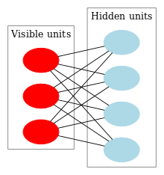
Each visible node takes low-level features from an item in the dataset to be learned. For example, MNIST images have 784 pixels, so neural nets processing them must have 784 input nodes on the visible layer.

Slide 9
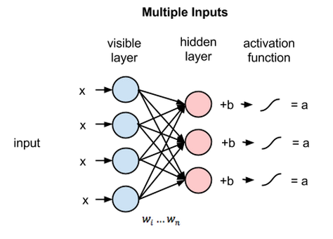
Deep Learning Building Block
Restricted Boltzmam Machine
One layer of visible units , One layer of hidden units and a bias unit
Each node is a locus of computation that processes input, and begins by making stochastic decisions about whether to transmit that input or not.
RBMs are shallow, two-layer neural nets that constitute the building blocks of deep-stochastic networks.
There is no intra-layer communication – this is the restriction in the Boltzmann machine

Slide 10
Forward Processing
Single pixel value, x, through the two-layer net.
At node 1 of the hidden layer, x is multiplied by a weight and added to a so-called bias.
The result of those two operations is fed into an activation function, which produces the node’s output, or the strength of the signal passing through it, given input x.
Forward pass:- RBM uses inputs to make predictions about node activations, or the probability of output given a weighted x: p(a|x; w)

Slide 11
RBM learns to Reconstruct Input
Backward pass:- RBM is attempting to estimate the probability of inputs x given activations a, which are weighted with the same coefficients as those used on the forward pass. This second phase can be expressed as p(x|a; w).
Together, those two estimates will lead to generate the joint probability distribution of inputs x and activations a, or p(x, a).
Reconstruction:- Making guesses about the probability distribution of the original input, known as generative learning.

Slide 12
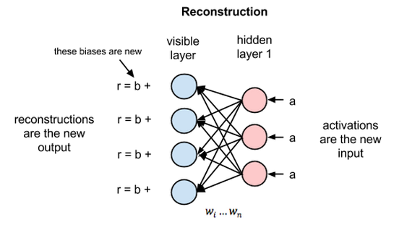
Reconstruction error as the difference between the values of r and the input values.
Error is then backpropagated and an iterative learning process continues until an error minimum is reached.

Slide 13
Approximation of the original input
Let, both the input data and the reconstructions are normal curves of different shapes, which only partially overlap.
To measure the distance between estimated probability distribution and the ground-truth distribution of the input, RBMs use Kullback Leibler Divergence.
KL-Divergence measures the non-overlapping, or diverging, areas under the two curves.
An RBM’s optimization algorithm attempts to minimize those areas so that the shared weights, when multiplied by activations of hidden layer one, produce a close approximation of the original input.
Notes:
1

Slide 14
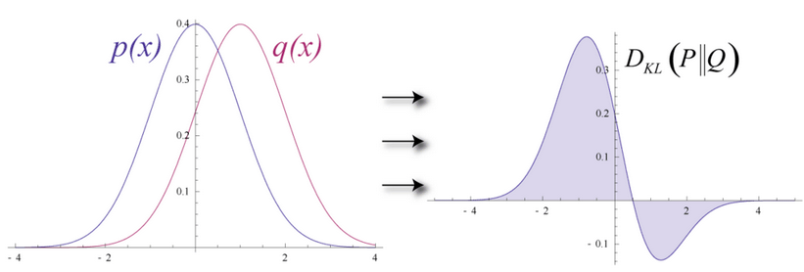

The simultaneous probability of ’x given a’ and of ’a given x’, expressed as the shared weights between the two layers of the RBM.
Reconstructed output
Original input
The process of learning reconstructions is, in a sense, learning which groups of pixels tend to co-occur for a given set of images.

Slide 15
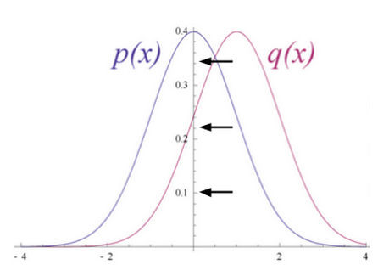
KL- Divergence
By iteratively adjusting the weights based on the error, an RBM learns to approximate the original data.
The weights slowly come to reflect the structure of the input, which is encoded in the activations of the first hidden layer.
The learning process looks like two probability distributions converging, step by step.

Slide 16
Autoencoder
An autoencoder neural network has three layers: an input layer, a hidden (encoding) layer, and a decoding layer.
An autoencoder neural network is an unsupervised Machine learning algorithm that applies backpropagation, setting the target values to be equal to the inputs.
The network is trained to reconstruct its inputs, which forces the hidden layer to try to learn good representations of the inputs.
Hidden layer describes a code used to represent the input.

Slide 17
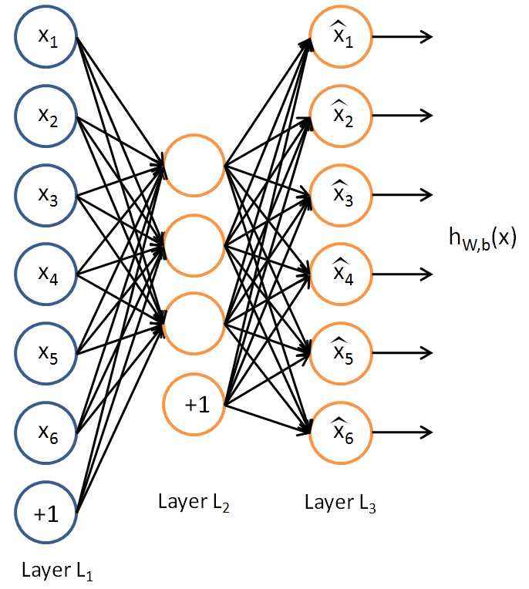
Autoencoder
The autoencoder tries to learn a function h_{W,b}(x) ≈ x
An approximation to the identity function, so as to output is similar to input.

Slide 18
Autoencoder
An Encoder function h= f(x) and a Decoder that produces a reconstruction r =g(h).
r = g (f(x)) where x is the input and r is the reconstructed output
Our goal is to have r ≈ x
Stochastic autoencoder uses functions p_{encoder}(h|x) and p_{decoder}(x|h).
In undercomplete AE, restriction of h having smaller dimension than x, in order to capture most salient features of training data distribution.

Slide 19
Undercomplete Autoencoder
Suppose the inputs x are the pixel intensity values from a 10×10 image (100 pixels) i.e. x ∈ ℜ¹⁰⁰ and y ∈ ℜ¹⁰⁰ and 50 hidden units in layer L2.
The network learns a ”compressed” representation of the input at the hidden layer and the network tries to ‘reconstruct’ the 100-pixel input x at the output layer.
This simple autoencoder learns a low-dimensional representation very similar to PCA if some of the input features are correlated.
The algorithm will be able to discover some of those correlations.
When the decoder is linear and L is the mean squared error, an undercomplete autoencoder learns to span the same subspace as PCA.

Slide 20
Learning AE
The learning process is described simply as minimizing a loss function L(x, g(f(x))).
When the decoder is linear and L is the mean squared error, an undercomplete autoencoder learns to span the same subspace as PCA.
An autoencoder trained to perform the copying task has learned the principal subspace of the training data.
Autoencoders with nonlinear encoder functions f and nonlinear decoder functions g can thus learn a more powerful nonlinear generalization of PCA.

Slide 21
Overcomplete and Regularized autoencoders
In overcomplete AE, the hidden code has dimension greater than the input.
In these cases, even a linear encoder and linear decoder can learn to copy the input to the output without learning anything useful about the data distribution.
Regularized AEs use a loss function that encourages the model to have other properties besides the ability to copy its input to its output.
These other properties include sparsity of the representation, smallness of the derivative of the representation, and robustness to noise or to missing inputs.

Slide 22
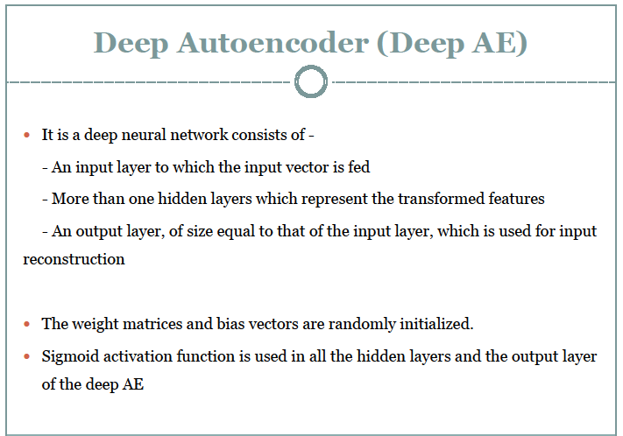

Slide 23
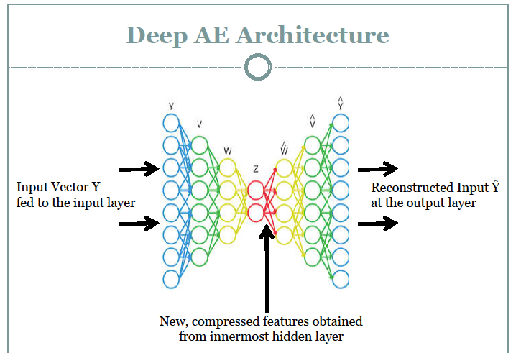

Slide 24
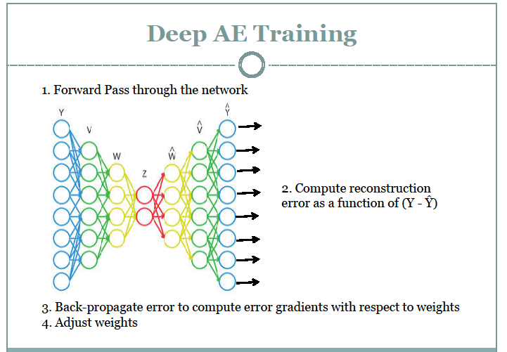

Slide 25
Introducing CNN
Every neuron in the network is connected to every neuron in adjacent layers.
For the 28×28 pixel images the network has 784784 (=28×28) input neurons.
We then trained the network's weights and biases so that the network's output would correctly identify the input image: '0', '1', '2', ..., '8', or '9'.
However, the network architecture does not take into account the spatial structure of the images.

Slide 26
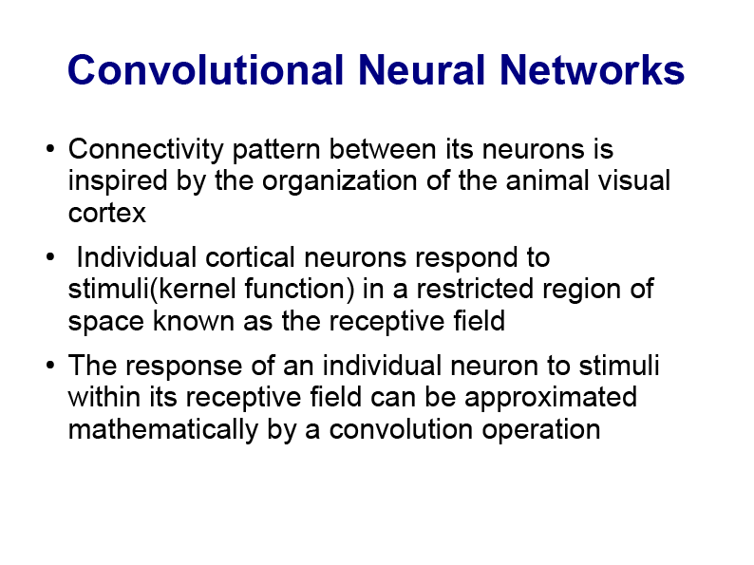

Slide 27
Convolution Neural Net
The structure of CNN is inspired by the complex arrangement of simple and complex cells of visual cortex.
Simple cells (convolution layer) are connected to a small subregion of the previous layer and need tiled to cover the entire visual space.
Complex cells (Pooling layer) combine the activation of simple cells to add robustness to small translation.
After several convolution and pooling layers, the activation of last convolution layer are fed into one or more dense layers to carry out the final classification task.

Slide 28
Convolution Neural Network
CNNs use a special architecture which is particularly well-adapted to classify images.
Convolutional neural networks use three basic ideas: local receptive fields, shared weights, and pooling.
In a convolutional net, the 28×28 pixel intensities using as inputs.
Connect the input pixels to a layer of hidden neurons where connections are made in small, localized regions of the input image.

Slide 29
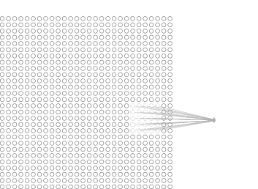
Local Receptive field
Each neuron in the first hidden layer will be connected to a small region of the input neurons
Hidden neuron
The region in the input image is called the local receptive field for the hidden neuron.
Each connection learns a weight.

Slide 30
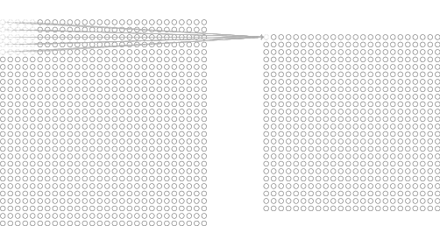
Hidden Layer
Slide the local receptive field across the entire input image and by sliding one pixel to the right (i.e., by one neuron), connect to a second hidden neuron and so on building the first hidden layer.
For each local receptive field, there is a different hidden neuron in the first hidden layer.
First Hidden layer
A different stride length is also used

Slide 31
Shared weights and biases
We use the same weights and bias for each of the 24×24 hidden neurons.
For the j,k-th hidden neuron, the output is:
σ (b+ ∑_{l} ∑_{m} w_{lm} a_{j+l,} _{k+m})
All the neurons in the first hidden layer detect exactly the same feature, just at different locations in the input image.
So useful to apply the same feature detector everywhere in the image.
Convolutional networks are well adapted to the translation invariance of images

Slide 32
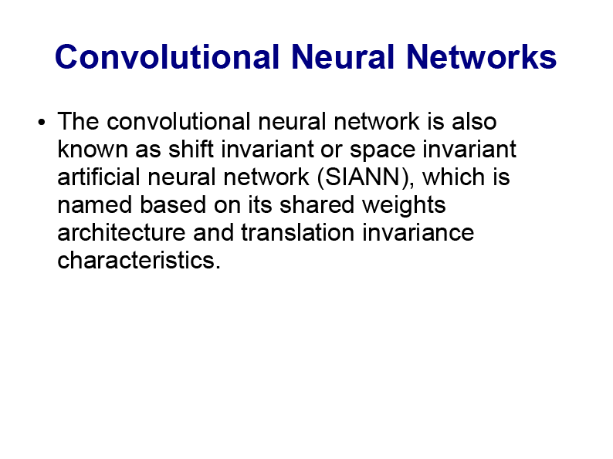

Slide 33
Convolution Neural Network
For this reason, we sometimes call the map from the input layer to the hidden layer a feature map.
We call the weights defining the feature map the shared weights and we call the bias defining the feature map in this way the shared bias.
The shared weights and bias are often said to define a kernel or filter.

Slide 34
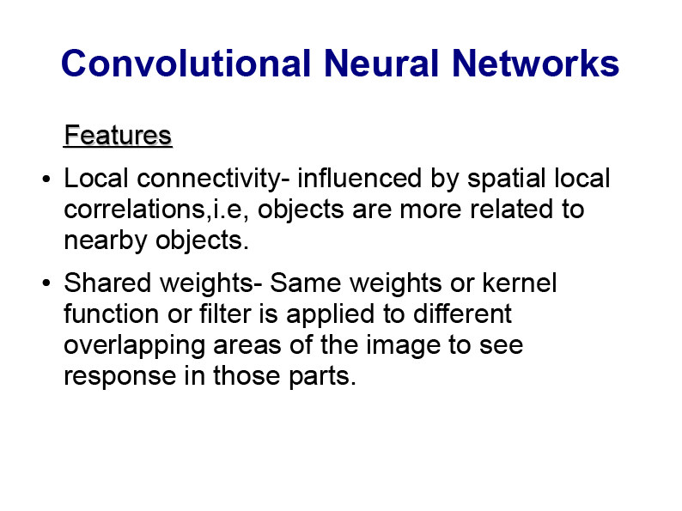

Slide 35
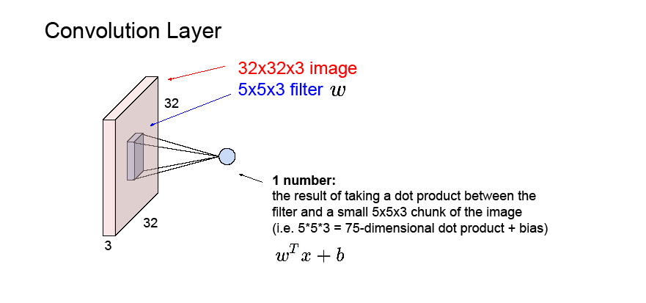

Slide 36
Convolutional Neural Networks
Convolutional Neural Networks are very similar to ordinary Neural Networks.
CNN are made up of neurons that have learnable weights and biases.
Each neuron receives some inputs, performs a dot product and optionally follows it with a non-linearity.
The network have a loss function (e.g. SVM/Softmax) on the last (fully-connected) layer and all steps of learning regular Neural Networks still apply.

Slide 37
So what does change?
It makes the forward function more efficient to implement and vastly reduce the amount of parameters in the network.
Regular Neural Nets don’t scale well to full images.
For example, an image of size, 200×200×3 (200 wide, 200 high, 3 color channels), would lead to a single fully-connected neuron in a first hidden layer with 200×200×3 = 120,000 weights.
Full connectivity is wasteful and the huge number of parameters would quickly lead to overfitting.

Slide 38
CONVOLUTION NEURAL NETWORK
The input consists of images and constrain the architecture in a more sensible way.
The neurons in a layer are connected to a small region of the layer before it, instead of all of the neurons in a fully-connected manner.
The final output layer have dimensions 1×1×10, because by the end of the ConvNet architecture we will reduce the full image into a single vector of class scores, arranged along the depth dimension.

Slide 39
Convolutional Neural Network
A Convolutional Neural Network (CNN) is comprised of one or more convolutional layers (often with a subsampling step) and then followed by one or more fully connected layers as in a standard multilayer neural network.
Local connections and tied weights followed by some form of pooling results in translation invariant features.
Another benefit of CNNs is that they are easier to train and have many fewer parameters than fully connected networks with the same number of hidden units.

Slide 40
Example: Edge Detection
Want to detect vertical and horizontal edges of image.
6×6×1 gray scale image
3×3 filter 4×4 Image
* =
Convolution is a linear operation – element wise matrix multiplication and addition .
3 | 0 | 1 | 2 | 7 | 4
1 | 5 | 8 | 9 | 3 | 1
2 | 7 | 2 | 5 | 1 | 3
0 | 1 | 3 | 1 | 7 | 8
4 | 2 | 1 | 6 | 2 | 8
2 | 4 | 5 | 2 | 3 | 9
1 | 0 | -1
1 | 0 | -1
1 | 0 | -1
-5 | -4 | 0 | 8
-10 | -2 | 2 | -3
0 | -2 | -4 | 7
-3 | -2 | -3 | -16

Slide 41
10 | 10 | 10 | 0 | 0 | 0
10 | 10 | 10 | 0 | 0 | 0
10 | 10 | 10 | 0 | 0 | 0
10 | 10 | 10 | 0 | 0 | 0
10 | 10 | 10 | 0 | 0 | 0
10 | 10 | 10 | 0 | 0 | 0
1 | 0 | -1
1 | 0 | -1
1 | 0 | -1
0 | 30 | 30 | 0
0 | 30 | 30 | 0
0 | 30 | 30 | 0
0 | 30 | 30 | 0
0 | 0 | 0 | 10 | 10 | 10
0 | 0 | 0 | 10 | 10 | 10
0 | 0 | 0 | 10 | 10 | 10
0 | 0 | 0 | 10 | 10 | 10
0 | 0 | 0 | 10 | 10 | 10
0 | 0 | 0 | 10 | 10 | 10
1 | 0 | -1
1 | 0 | -1
1 | 0 | -1
0 | -30 | -30 | 0
0 | -30 | -30 | 0
0 | -30 | -30 | 0
0 | -30 | -30 | 0

Slide 42
Horizontal Edge detection
1 | 1 | 1
0 | 0 | 0
-1 | -1 | -1
10 | 10 | 10 | 0 | 0 | 0
10 | 10 | 10 | 0 | 0 | 0
10 | 10 | 10 | 0 | 0 | 0
0 | 0 | 0 | 10 | 10 | 10
0 | 0 | 0 | 10 | 10 | 10
0 | 0 | 0 | 10 | 10 | 10
W1 | W2 | W3
W4 | W5 | W6
W7 | W8 | W9

Slide 43
PADDING
n×n Image size convolves with m×m kernel generateing image of size (n-m+1) × (n-m+1).
Pixels at the boundary are involved less compare to the pixels which are inside.
So pad the image and image size increases by 2 (i.e. 8 × 8) and original image is of size 6 ×6.
If padding by 1, i.e. p =1 then generated image size is (n+2p-m+1) ×(n+2p-m+1)
For stride length more than one, padding is also needed.

Slide 44
Convolution on volume
RGB image
3 ×3 ×3= 27 numbers after convolution
generate a
single value as the element of the
convolved image of size 4 ×4
No. of channels of image and filter must match.
Generated image is of single channel.
If we use two different filters then channel of generator matrix will be 2

Slide 45
Property
Add bias with every convolved image and apply nonlinearity to transform the image.
Stack of such images are obtained in a layer.
Say there is 10 different 3 ×3 ×3 filters.
So 27 weights + 1 bias= 28 parameters and 10 such filters mean 280 parameters.
Whatever is the input image size number of parameters are 280.
So convolution net is less prone to overfitting.

Slide 46
Deep CNN
Problem is of image classification.
Say, an input image of size 39×39×3
Activation of the next layer generates image of dimension 37×37×10 with stride 1, no padding using 3×3×3 filter, and 10 such filters.
Say, another Convlution layer with 5×5 filter, stride 2, no padding and 20 filters generate 17×17×20 dimensional feature map.
Add one more Convolution layer using filter size 5×5×40, generating 7×7×40 dimensional features map, so 1960 nodes.
Add softmax in the classification layer to predict the final output

Slide 47
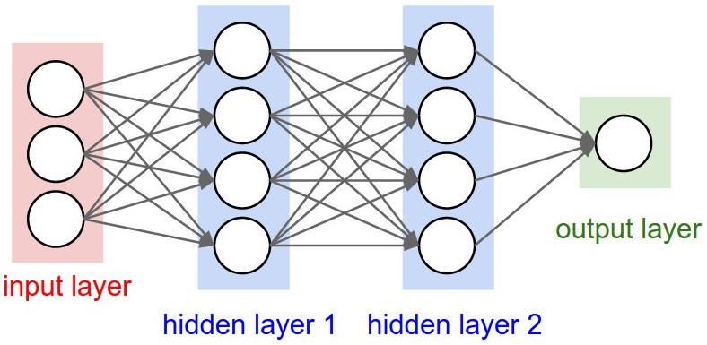
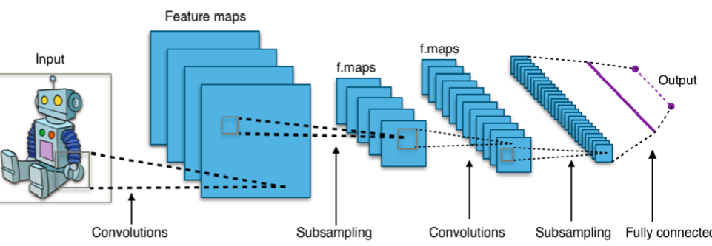
A regular 3-layer Neural Network.

Slide 48
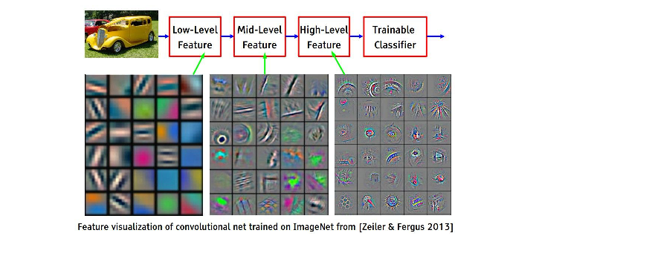

Slide 49
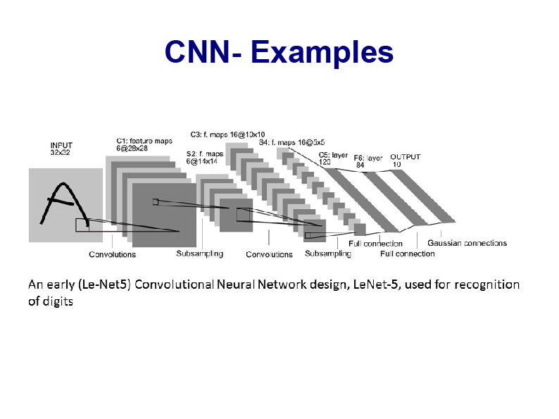

Slide 50
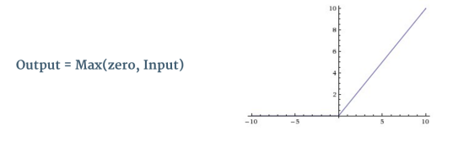
Non Linearity (ReLU)
Rectified Linear Unit is a non-linear function used after every Convolution operation.
ReLU is an element wise operation applied per pixel and replaces all negative pixel values in the feature map by zero.
The purpose of ReLU is to introduce non-linearity in our ConvNet, since most of the real-world data we would want our ConvNet to learn would be non-linear so we account for non-linearity by introducing a non-linear function like ReLU.

Slide 51
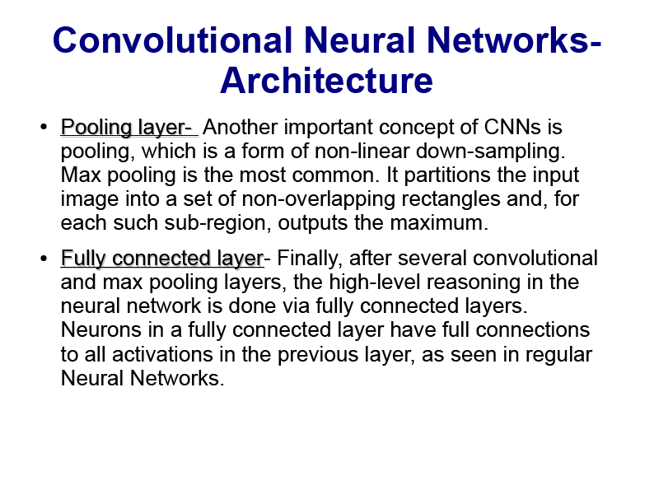

Slide 52
The Pooling Step
Spatial Pooling (also called subsampling or downsampling) reduces the dimensionality of each feature map but retains the most important information. Spatial Pooling can be of different types: Max, Average, Sum etc.
In case of Max Pooling, we define a spatial neighborhood (for example, a 2×2 window) and take the largest element from the rectified feature map within that window.
Instead of taking the largest element we could also take the average (Average Pooling) or sum of all elements in that window. In practice, Max Pooling has been shown to work better.

Slide 53
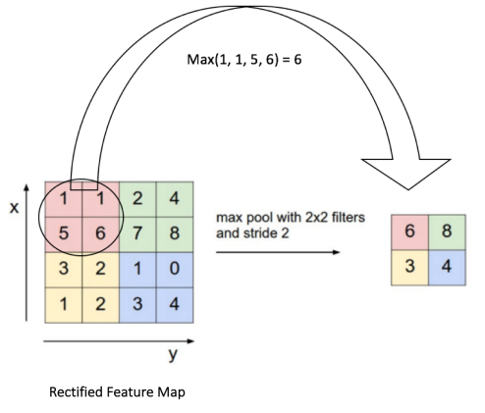
Max Pooling
Pooling reduces the dimensionality of our feature map.
pooling operation is applied separately to each feature map

Slide 54
Fully Connected Layer
The Fully Connected layer is a traditional Multi Layer Perceptron that uses a softmax activation function in the output layer.
The term “Fully Connected” implies that every neuron in the previous layer is connected to every neuron on the next layer.
The output from the convolutional and pooling layers represent high-level features of the input image.
The purpose of the Fully Connected layer is to use these features for classifying the input image into various classes based on the training dataset.

Slide 55
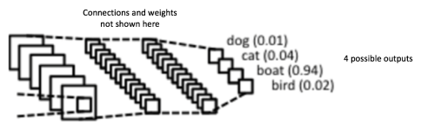
Classification
Apart from classification, adding a fully-connected layer is also a (usually) cheap way of learning non-linear combinations of these features.
Most of the features from convolutional and pooling layers may be good for the classification task, but combinations of those features might be even better.
The sum of output probabilities from the Fully Connected Layer is 1 ensured by using the Softmax as the activation function.
The Softmax function takes a vector of arbitrary real-valued scores and squashes it to a vector of values between zero and one that sum to one.

Slide 56
Functions
ConvNets transform the original image layer by layer from the original pixel values to the final class scores.
Some layers contain parameters and other don’t.
In particular, the CONV/FC layers perform transformations that are a function of not only the activations in the input volume, but also of the parameters (the weights and biases of the neurons).
On the other hand, the ReLU layers implement a fixed function.
The parameters in the CONV/FC layers are trained with gradient descent so that the class scores that the ConvNet computes are consistent with the labels in the training set for each image.

Slide 57
Architecture
A ConvNet for CIFAR-10 classification have the architecture [INPUT - CONV - ReLU - POOL - FC]
INPUT: [32×32×3] raw pixel values of image.
CONV layer computes the output of neurons connected to local regions in the input using 12 filters.
ReLU layer applies an element wise activation function, such as the max(0, x); thresholding at zero.
POOL layer performs a downsampling operation resulting [16×16×12].
FC layer will compute the class scores of 10 numbers, resulting in volume of size [1×1×10], representing 10 categories of CIFAR-10.

Slide 58
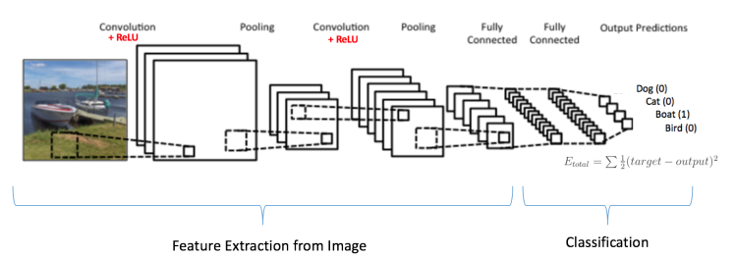
Training using Backpropagation
The Convolution + Pooling layers act as Feature Extractors from the input image while Fully Connected layer acts as a classifier.
Note that, since the input image is a boat, the target probability is 1 for Boat class and 0 for other three classes, i.e. Input Image = Boat and Target Vector = [0, 0, 1, 0]

Slide 59
Step1: Initialize filters and weights with random values
Step2: The network takes a training image as input, then forward propagation step (convolution, ReLU and pooling operations along with forward propagation in the Fully Connected layer) and finds the output probabilities for each class.
Lets say the output probabilities for the boat image above are [0.2, 0.4, 0.1, 0.3]
Since weights are randomly assigned for the first training example, output probabilities are also random.
Step3: Calculate the total error at the output layer
Total Error = ∑ ½ (target probability – output probability) ²

Slide 60
Step4: Use Backpropagation to calculate the gradients of the error with respect to all weights in the network and use gradient descent to update all filter values / weights and parameter values to minimize the output error.
The weights are adjusted in proportion to their contribution to the total error.
When the same image is input again, output probabilities might now be [0.1, 0.1, 0.7, 0.1], which is closer to the target vector [0, 0, 1, 0].
This means that the network has learnt to classify this particular image correctly by adjusting its weights / filters such that the output error is reduced.

Slide 61
Parameters like number of filters, filter sizes, architecture of the network etc. have all been fixed before Step 1 and do not change during training process – only the values of the filter matrix and connection weights get updated.
Step5: Repeat steps 2-4 with all images.

Slide 62
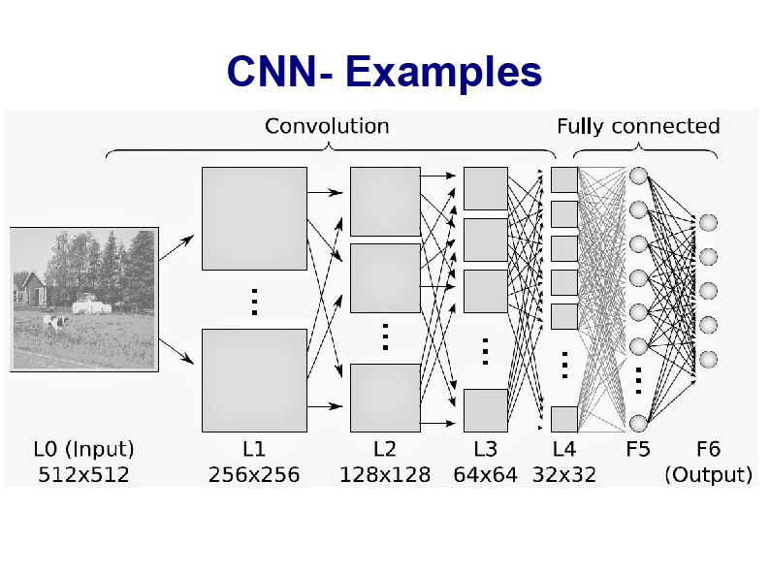

Slide 63
How can we train such deep networks?
Deep networks not performing much better than shallow networks using stochastic gradient descent by backpropagation
Different layers in deep network are learning at vastly different speeds.
When later layers (early layers) in the network are learning well, early layers (later layer) often get stuck during training, learning almost nothing at all.
There's an intrinsic instability associated to learning by gradient descent in deep, many-layer neural networks resulting resulting stuck at during training either the early or the later layers.

Slide 64
Problem with Learning Algorithm
Assume that the extra hidden layers really could help in principle, and the problem is that our learning algorithm isn't finding the right weights and biases.
The gradient tends to get smaller as we move backward through the hidden layers. Neurons in the earlier layers learn much more slowly than neurons in later layers.
The phenomenon is known as the vanishing gradient problem.
More generally, it turns out that the gradient in deep neural networks is unstable, tending to either explode or vanish in earlier layers.
This instability is a fundamental problem for gradient-based learning in deep neural networks.

Slide 65
Response to vanishing gradient problem: Randomly initialized the weight and biases in the network
Other Issues
Choice of activation function,
The way weights are initialized,
Details of how learning by gradient descent is implemented.
Choice of network architecture and other hyper-parameters is also important.

Slide 66
Goals
Needs knowledge,
Needs learning
Needs generalization (Guess some ‘structure’ and generalize
Accordingly)
Needs ways to fight the curse of dimensionality (Exploiting
compositionality gives an exponential gain in representational
power)
Needs disentangling (# of distinguishable regions grows almost exponentially with # of Parameters)

Slide 67
Results
Invariant features
Good disentangling avoid the curse of dimensionality
Deep composition of nonlinearities

Slide 68
Conclusion
Thus, many factors can play a role in making deep networks hard to train, and understanding all those factors is still a subject of ongoing research.

